Slide 1




Crime Analysis Against Women
"Women's safety is not a privilege; it's a basic human right."

Slide 2
Contents
Introduction
Data Analysis with SQL and Power BI
Dashboard
Type of crimes
Safety Measuares
Insights

Slide 3
Introduction
Crime Analysis Against is one of most common reported cases in India in this crime analysis against women I have designed a based on the crime analysis dataset from 2010 to 2014 using Power bi and SQL

Slide 4
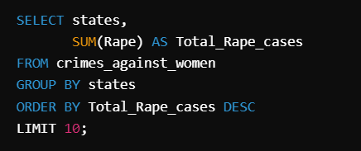
Data Analysis Using SQL
Top 10 States :
Here is the SQL query to retrieve the top 10 states which are getting highest crime reports based Rapes against women's
QUERY

Slide 5
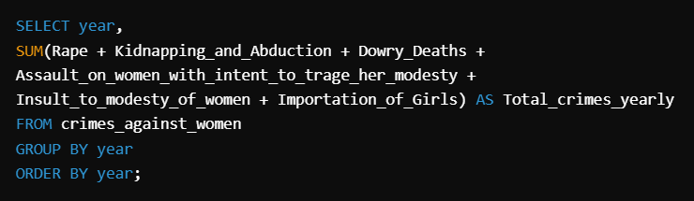
Data Analysis Using SQL
Total Crimes Per Year :
Here is the SQL query to retrieve the year wise total crimes against women in India from 2001 to 2014
QUERY

Slide 6
Data Analysis Using Power BI
Data Analysis user power bi consists of
The Key insights in this crime Dashboard are
Crime Report By Year
Crime Report by State
Crime Report Count Based on Crime Type

Slide 7
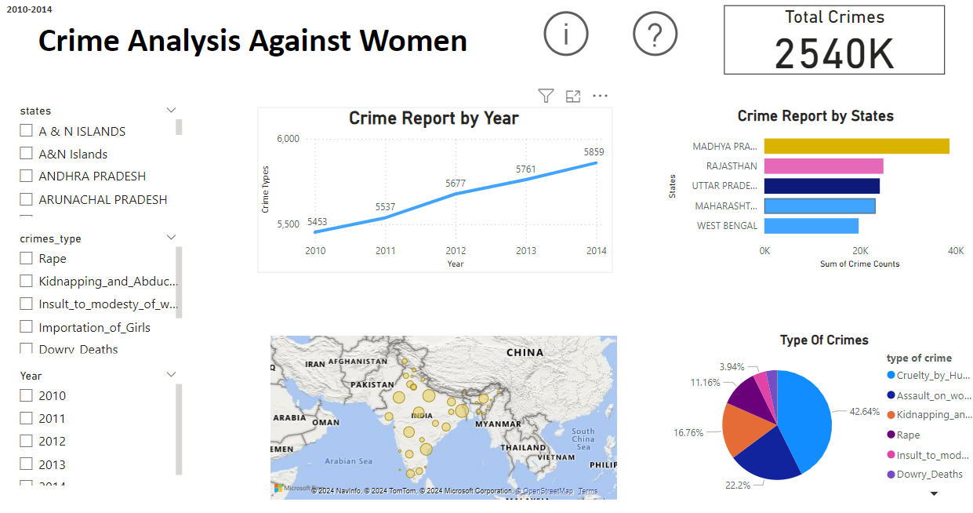
Dashboard

Slide 8


Women Safety
Types of Crimes
Gender-Based Violence
Gender-based violence encompasses physical, sexual, and psychological abuse targeted at women. It includes domestic violence, sexual assault, harassment, and human trafficking. Addressing gender-based violence requires a multi-faceted approach involving prevention, intervention, and support for survivors

Slide 9

Women Safety
Types of Crimes
Street harassment refers to unwanted verbal, physical, or sexual attention that women experience in public spaces. It includes behaviors like catcalling, stalking, and groping. Street harassment undermines women's safety, restricts their freedom of movement, and contributes to a culture of intimidation and fear.
Street Harassment

Slide 10

Women Safety
Types of Crimes
Domestic Violence
Domestic violence involves a pattern of abusive behaviors, including physical, sexual, emotional, and economic abuse, that occurs within intimate relationships. It is a violation of women's rights and poses significant physical and psychological harm. Addressing domestic violence requires a comprehensive approach, including providing safe shelters, counseling services, legal protection, and promoting public awareness to break the cycle of abuse.

Slide 11



Women Safety
Types of Crimes
Sexual Assault
Sexual assault refers to any unwanted sexual contact or behavior without consent. It is a traumatic experience that can have long-lasting effects on survivors. Combating sexual assault requires comprehensive measures such as educating individuals about consent, providing trauma-informed support services, improving legal frameworks, and promoting a survivor-centered approach to justice.

Slide 12



Women Safety
Types of Crimes
Human trafficking involves the recruitment, transportation, harboring, or exploitation of individuals, primarily women and girls, for forced labor, sexual exploitation, or other forms of slavery. Addressing human trafficking requires a multi-pronged approach, including prevention through education, identifying and assisting victims, prosecuting traffickers, and addressing the root causes such as poverty and gender inequality.
Human Trafficking

Slide 13

Women Safety
Safety Measures
Women's safety in public transportation is crucial for ensuring their mobility and access to essential services. It involves implementing measures to prevent harassment and assault on public transport systems, such as increasing security presence, improving lighting, providing emergency help points, and promoting awareness campaigns to create a culture of respect and safety.
Women's Safety in Public Transportation

Slide 14

Women Safety
Safety Measures
Workplace Safety
Women should feel safe and respected in their workplaces. Ensuring women's safety in the workplace involves implementing measures to prevent sexual harassment, discrimination, and unequal treatment. This includes promoting gender-sensitive policies, providing harassment prevention training, establishing clear reporting mechanisms, and fostering a culture of respect and equality.

Slide 15

Women Safety
Safety Measures
Legal Protection and Access to Justice
Ensuring women have access to effective legal protection and justice systems is crucial for their safety and empowerment. This includes strengthening laws against gender-based violence, improving the responsiveness of law enforcement agencies, establishing specialized courts

Slide 16
Women Safety
INSIGHTS
Rise in Crime Rates:
crimes against women increased significantly from 410,000 in 2010 to 635,000 in 2014 The jump between 2012 to 2013 is concerning
Domestic Violence:
cruelty by husband or relative are getting highly reported cases 42.64% cases are from cruelty only
Assault on Kidnapping:
Assault on age getting high rate of percentages in 2010 to 2014 years the reported percentage of assault on women is 22.2%

Slide 17
Women Safety
INSIGHTS
Rapes Cases By States
Top 5 states are getting high reports on rape cases and those are
Madhya Pradesh- Reported Cases 38754
Rajasthan - Reported Cases 24928
Uttar Pradesh - Reported Cases 24170
Maharashtra - Reported Cases 23280
INSIGHTS

Slide 18


Thank You!
We respect your valuable time

